Slide 1

RedShift
Brings Cornell University to Current and Future Leaders
Ivy League meets real world

Slide 2
Agenda
What is RedShift ?
Benefits
How to Get Started
User Dashboard
Course Environment
Best Practices
Resources & Support

Slide 3






What is RedShift ?
IVY LEAGUE
100% ONLINE
REAL-WORLD
COLLABORATION
1-TO-1 EXPERTS
CERTIFICATES
MBA-level project-based, actionable Ivy League learning
45+ courses and 200+ topics on:
Leadership
Marketing
Strategy
Project Execution
High-Performance Leadership

Slide 4
Why RedShift?
IVY LEAGUE
100% ONLINE
REAL-WORLD
COLLABORATION
1-TO-1 EXPERTS
CERTIFICATES
Wide array of topics
Directly relatable assignments and projects
Apply course concepts to your current workplace challenges
Unlimited access to one-on-one instructor feedback

Slide 5


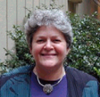



Expert Instructors
IVY LEAGUE
100% ONLINE
REAL-WORLD
COLLABORATION
1-TO-1 EXPERTS
CERTIFICATES
Susan Alevas
High-Performance Leadership
Senior HR Executive
and Lawyer
Robert Emborski
Project Leadership
Project Manager
and Business Analyst
for IT and Professional Services
Jan Nickerson
Management Reporting
Corporate Executive in the
High Tech and
Consumer Industries
Arun Sharma
Business Strategy
Managing Partner in the
Financial Services Sector
Kay Green
Data-Driven Marketing
Marketing Strategy
CEO/President
with expertise in Corporate and
Small Business Marketing
Uwe Wagner
Marketing Strategy
New Media Marketing
C-Level Executive
in the International
Hospitality Industry

Slide 6
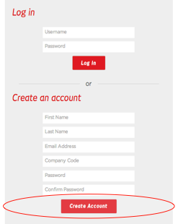
How to Get Started
Go to: redshift.ecornell.com
Create an Account:
Enter Your RedShift Company Code
  intuitinc
Successful login launches your RedShift User Dashboard
  *Password requirements
  Minimum of 10 Characters
  At least one capital letter
  At least one number At least one non-alphanumeric character

Slide 7
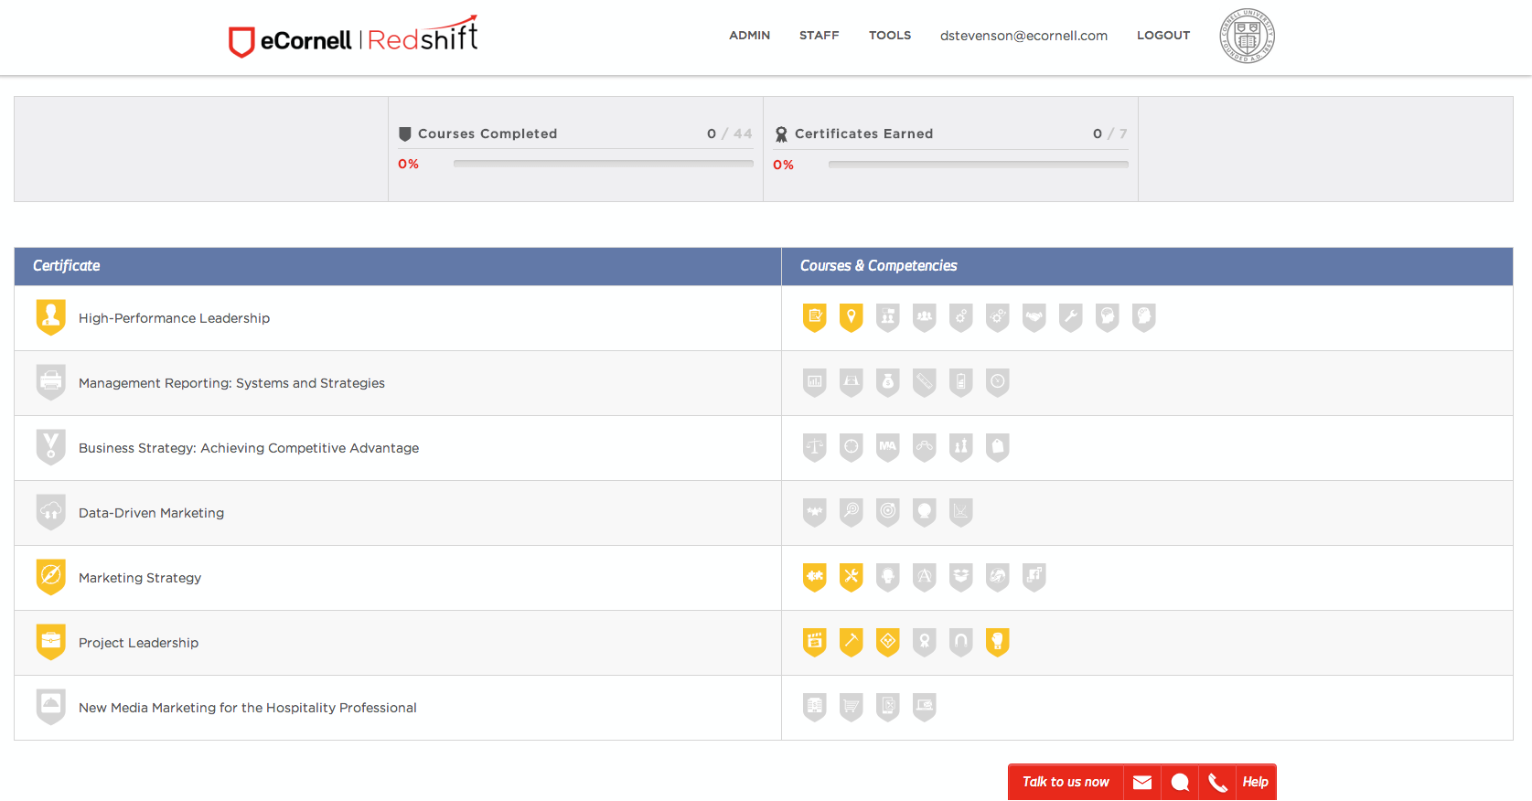



User Dashboard
Not in Progress
In Progress
Complete

Slide 8
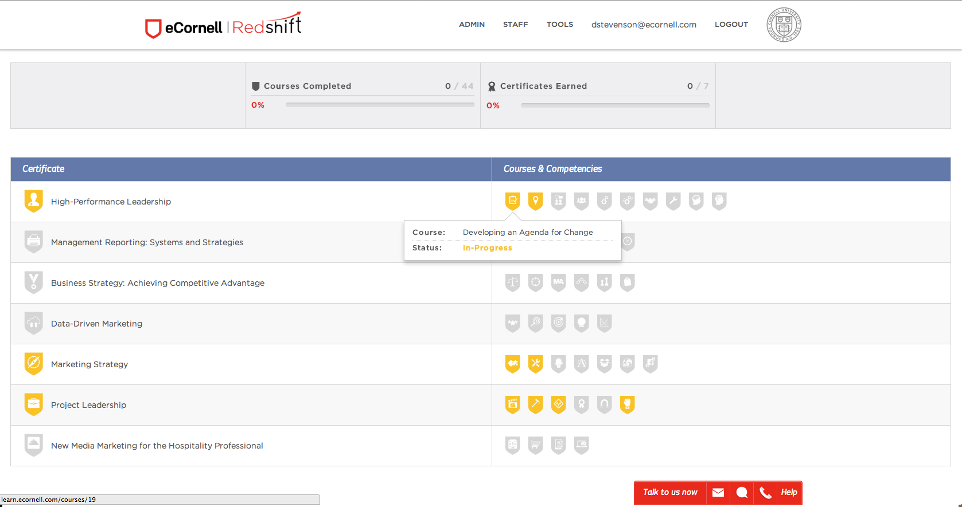

Slide 9
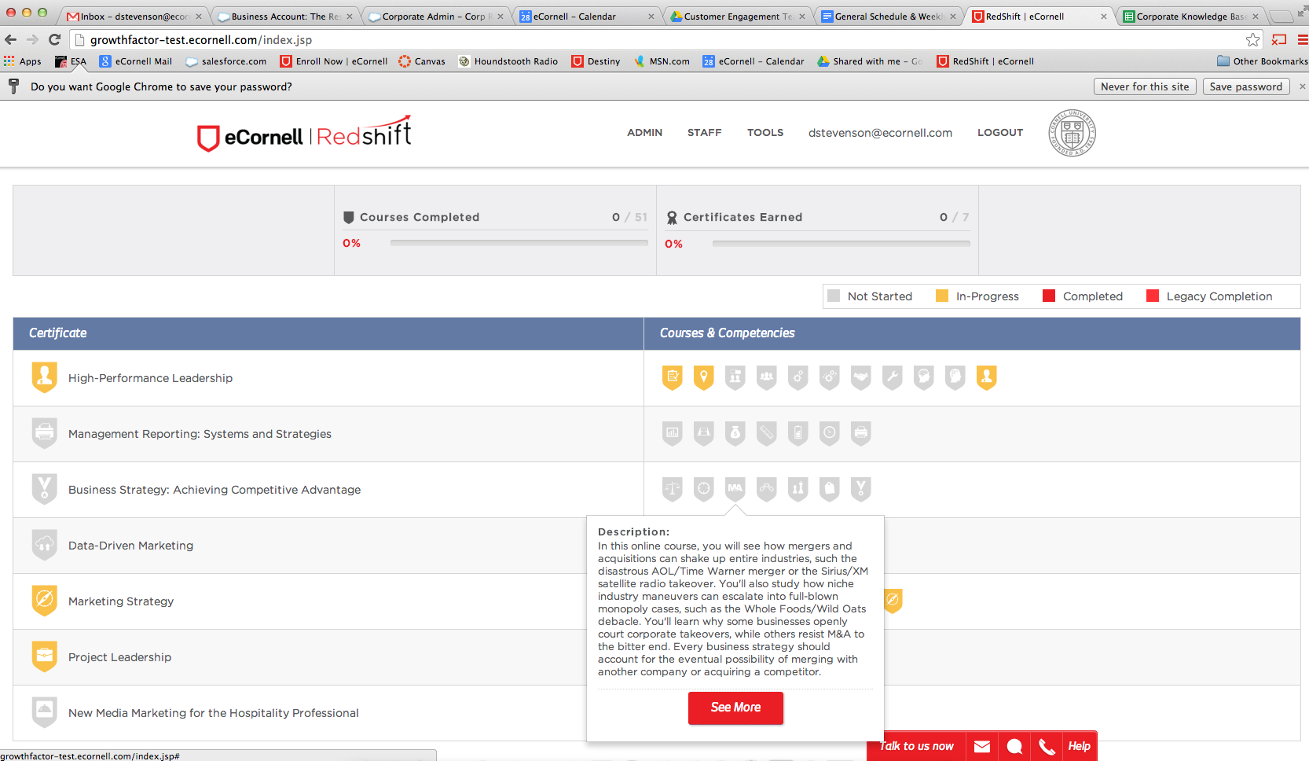

Slide 10
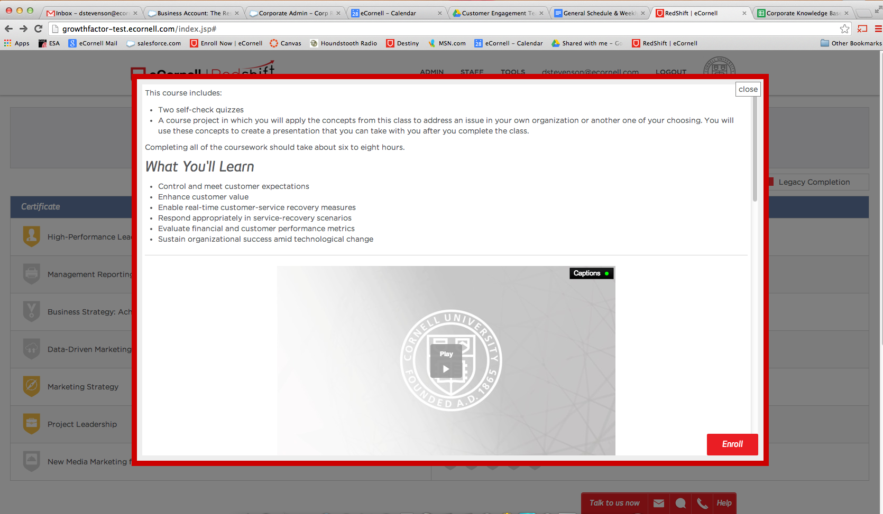
This information will be of interest

Slide 11
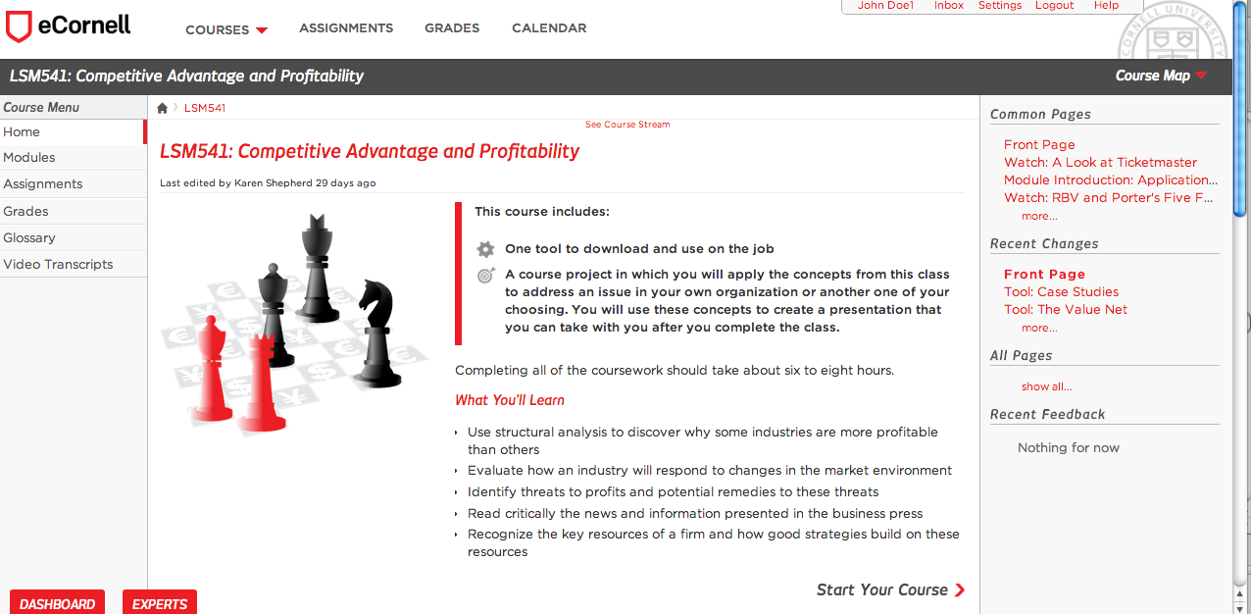
Course Environment
Navigating Your Course

Slide 12
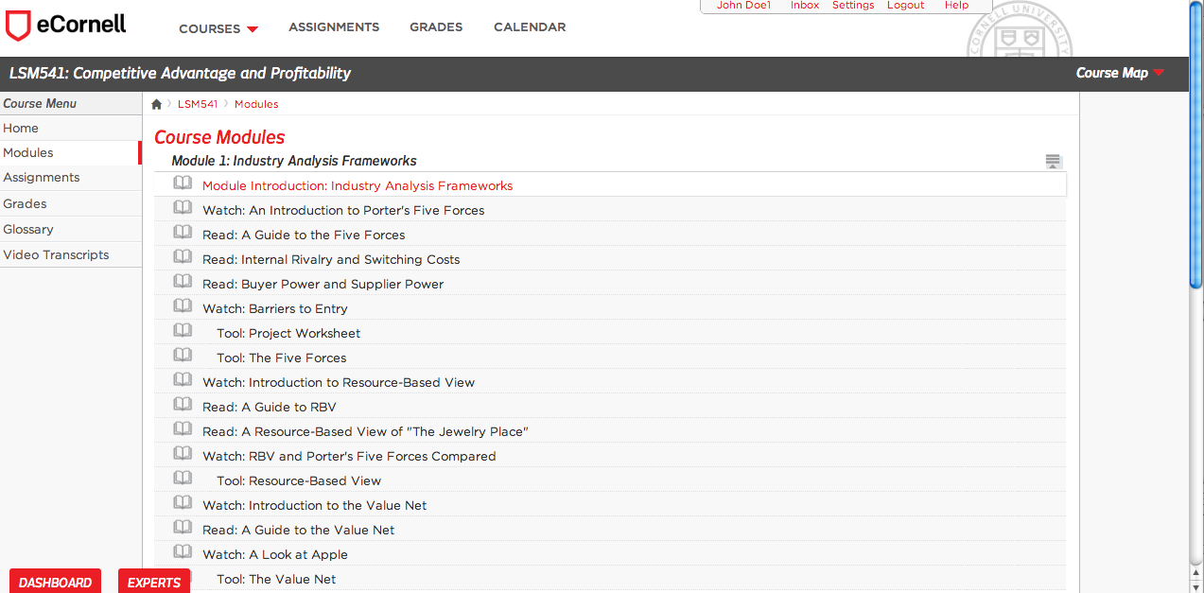

Navigating Your Course
In Modules, review content & complete required submissions
eCornell.com

Slide 13
Meet with an Expert
eCornell Expert Instructors: A Benefit of RedShift
Help relating concepts back to your work
Provide constructive feedback
Answer content related questions
Objectively help you develop your ideas
Notes:
Questions to clarify course content
Need help directly relating concepts to work situations
Need help with course presentation
Scenarios may not be immediately obvious
After the presentation is written, how to bring the ideas to your company (manager)
You can work with an expert to build out and polish your presentation to be board room ready
Experts will ask you to improve upon your ideas
Objective observer/sounding board
An opportunity to have an objective, challenging conversation about the assumptions in your presentation.

Slide 14
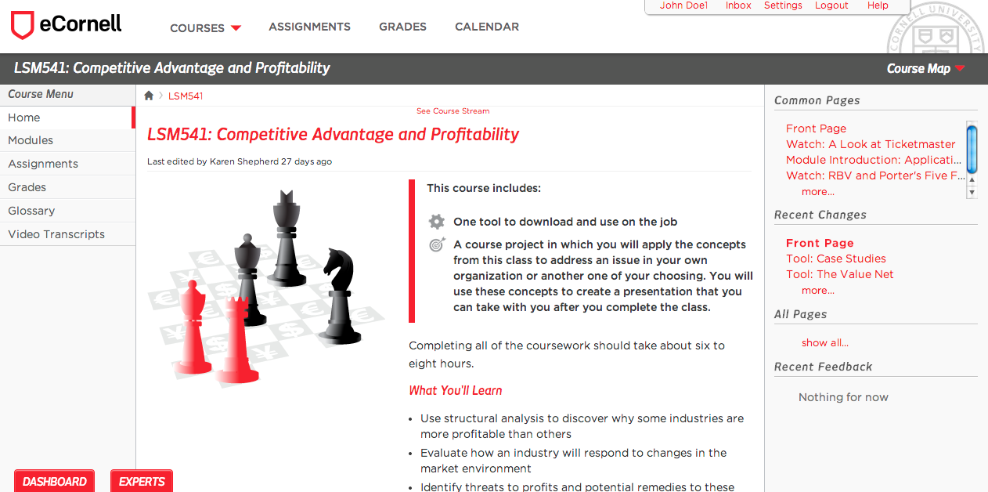
Schedule an Appointment

Slide 15
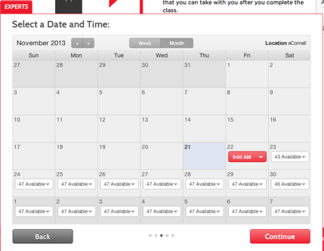
Appointment Confirmation

Slide 16
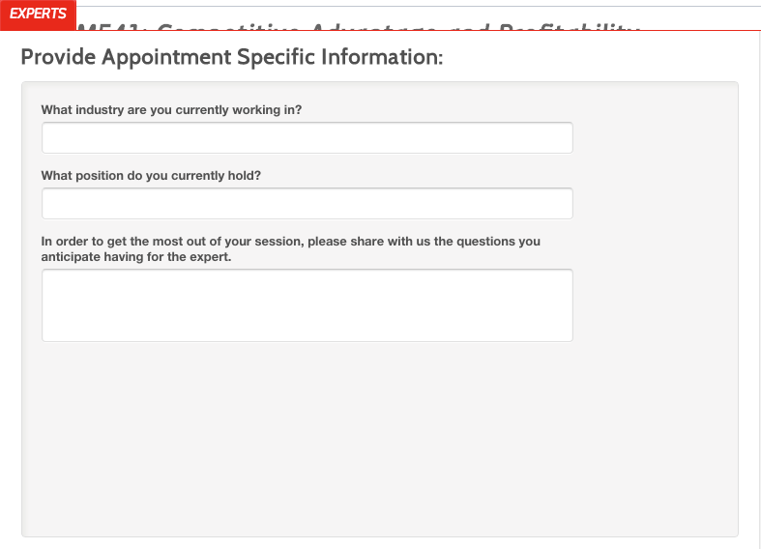
Appointment Confirmation

Slide 17
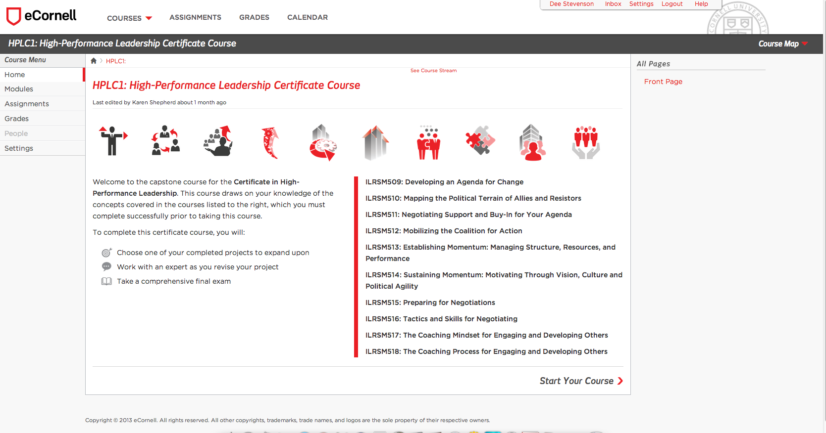
How to earn a Certificate Appointment

Slide 18
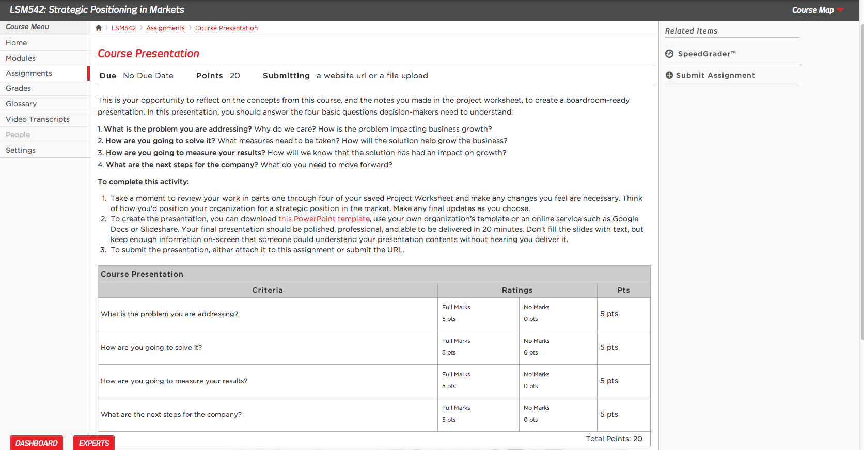

Slide 19
Best Practices
Schedule ~ 10-12 hours per course
Aim to complete a course in ~ 3 weeks
Earn a certificate in 3-6 months
Discuss business issues in Fourm
Network with peers
Collaborate on course outcomes once everyone has completed their own individual projects

Slide 20
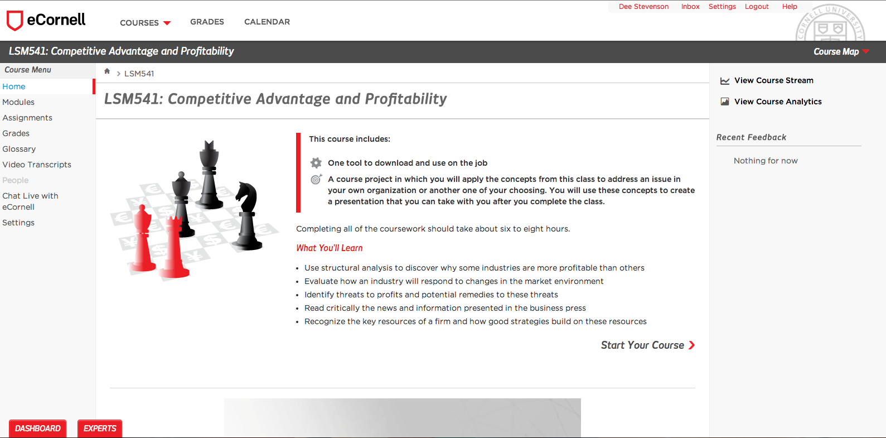
Resources & Support
Expert Instructors
  On-demand and unlimited
  30 minute scheduling sessions
  As many sessions as you need
Academic Support available through live chat & email
  Assignment questions
  Course content questions

Slide 21
Resources & Support
Problems with Access? Technical questions?
eCornell’s Help Desk
helpdesk@ecornell.com
800-801-0287 or 607-330-3200 x 4
Monday – Friday: 24/5 Eastern Standard Time, U.S.
Knowledge Base
  On-line, 24/7 answers to frequently asked questions
  Go to: ecornell.force.com/rshelp
General account questions
  Account Manager: Dee Stevenson
  DStevenson@ecornell.com
  607-330-3250

